Slide 1
Summalyze
James ruben
Nithin tumma
Neel patel
Eddy Grafstein
Notes:
Hey! Welcome to Summalyze, the CS51 Final Project for James, Nithin, Neel, and Eddy

Slide 2
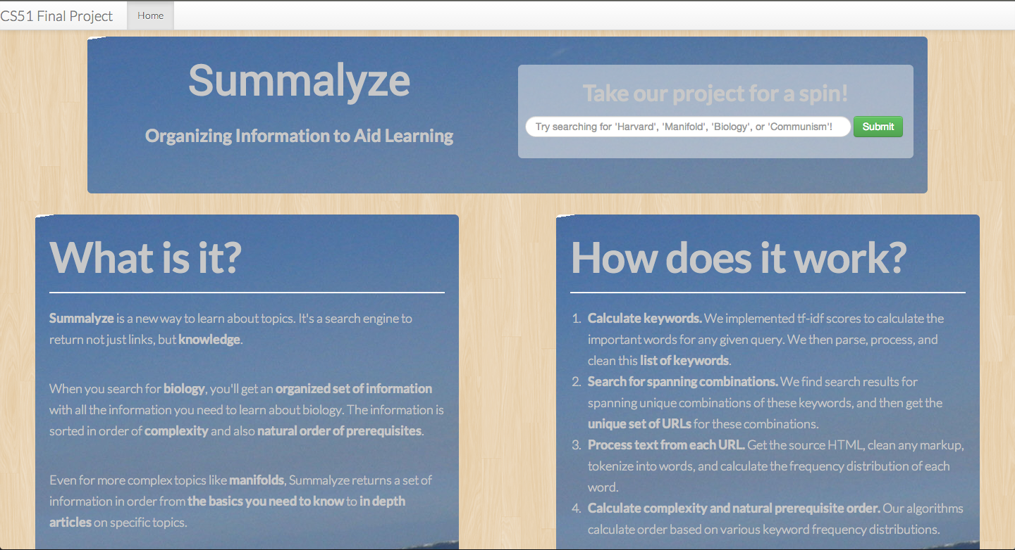
What We Did
Summalyze returns knowledge, not just URLs
Results in order of complexity + natural prerequisite order
Notes:
Summalyze is a way to naturally order search results to facilitate learning.
With Summalyze, when you search for a topic, we return everything you need to learn about that topic – in order of complexity, and also in the natural order of what you need to learn about first.

Slide 3


Tf-Idf: Determines Key Words
TF = term frequency
The occurrence of a term in this document
IDF = inverse document frequency
Occurrence of term across all documents (corpus)
TF-IDF Score
High tf-idf scores indicates a keyword
Notes:
The first major algorithm we used was tf-idf scores, which we used to calculate keywords in an article.
It’s based on the number of times a term appears in this article as well as across a corpus of articles.

Slide 4
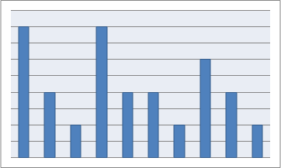
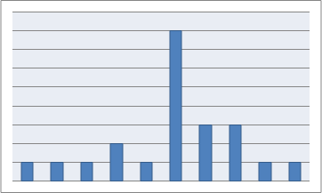
Summarability Score
VS
A measure of complexity
Compared frequency distribution of keywords in wiki vs article
Similar distribution = similar to summary = low complexity
Different distribution = more in depth on a topic = high complexity
Notes:
Next we created an algorithm to measure the complexity of an article.
Our program compared the frequency distribution of keywords in a wikipedia article to the distribution in any given article, using the similarity in distributions to measure depth/complexity.

Slide 5
Orderability Score
Determine natural ordering based on occurrence in wiki article
Sort frequency distribution by natural ordering, and found ‘balancing point’
Skew towards early words = likely to be prerequisite article
Notes:
Our orderability algorithm was based on how well a given article represented the natural ordering of keywords. We used this to measure how much of a ‘prerequisite’ a given article was

Slide 6
Final Score
10 URLs
URLs overall sorted by summarability
Each small segment sorted by orderability
10 URLs
10 URLs
Uses summarability score to sort overall list
Use orderability to refine sort within ‘buckets’
Notes:
Finally, we used the summarability score to sort our overall list of URLs, and orderability to make refinements.

